Slide 1


Hua Lung Jao
December 31, 2023

Slide 2

Outline
Executive Summary
Introduction
Methodology
Results
Conclusion
Appendix

Slide 3
Executive Summary
Summary of methodologies
Data Collection (API & Webscrapping)
Data Wrangling
Data Analysis (SQL, Visualization, Interactive)
Prediction with Machine Learning
Summary of all results
Exploratory Data
Screenshots of Interactive Analytics
Predictive Analytics Finding

Slide 4
Introduction
Project background and context
Space X’s Falcon 9 rocket costs 62 million dollars with each launch, while other providers cost upward of 165 million dollars. Much of this savings is a result of Space X reusing the first stage.
If an alternate company can predict whether the first stage will land successfully, we can determine the cost of a launch, and therefore bid against space X for a rocket launch.
Problems you want to find answers
Factors which determine successful landing of the Falcon 9 rockets

Slide 5

Section 1

Slide 6
Methodology
Executive Summary
Data collection methodology:
API Provided by SpaceX
Webscrapping (wiki)
Perform data wrangling
Data cleaned up and re-labeled landing outcome with success/failure category
Perform exploratory data analysis (EDA) using visualization and SQL
Perform interactive visual analytics using Folium and Plotly Dash
Perform predictive analysis using classification models
Evaluated different models (logistic regression, support vector machine, decision tree, k-nearest neighbor) using training and compared accuarcy

Slide 7
Data Collection
Request: SpaceX API
https://api.spacexdata.com/v4/launches/past

Slide 8
Data Collection – SpaceX API
Data Flow:
Get – Response (REST API)
Format Raw Data in JSON
Normalize Data
Output to CSV
Ready for Wrangling
Link To Source Code

Slide 9
Data Collection - Scraping
Data Flow:
Beautiful Soup API
Format HTML data to Data Frame
Link to Source Code

Slide 10
Data Wrangling
Analyzed for Missing Values and Data Types
Calculated # of Launches per Site, and per destination (orbit)
Calculated # of occurence of mission outcome of the orbits
Created landing outcome label from Outcome column
Liink To Source Code

Slide 11
EDA with Data Visualization
Charts Used:
Cat Plot: Visualizing Correlation between 2 variables
Scatter Plot: Visualizing Relationship between 2 variables
Bar Chart: Compare rate of success within one feature
Line Chart: Looking at historic trend
edwardjao-Coursera_DSC10/module 2 - jupyter-labs-eda-dataviz.ipynb at main · edwardjao/edwardjao-Coursera_DSC10 (github.com)

Slide 12
EDA with SQL
Created Table
Display the total payload mass carried by boosters launched by NASA (CRS)
Display average payload mass carried by booster version F9 v1.1
List the names of the boosters which have success in drone ship and have payload mass greater than 4000 but less than 6000
List the names of the booster_versions which have carried the maximum payload mass.
List the records which will display the month names, failure landing_outcomes in drone ship ,booster versions, launch_site for the months in year 2015
Rank the count of landing outcomes (such as Failure (drone ship) or Success (ground pad)) between the date 2010-06-04 and 2017-03-20, in descending order.
edwardjao-Coursera_DSC10/module 2 - jupyter-labs-eda-sql-coursera_sqllite.ipynb at main · edwardjao/edwardjao-Coursera_DSC10 (github.com)

Slide 13
Build an Interactive Map with Folium
Circle - Marked all launch sites on a map
Marker - Marked the success/failed launches for each site on the map
Distance Line – Marked the distances between a launch site to its proximity
edwardjao-Coursera_DSC10/module_3_lab_jupyter_launch_site_location.jupyterlite.ipynb at main · edwardjao/edwardjao-Coursera_DSC10 (github.com)

Slide 14
Build a Dashboard with Plotly Dash
Added Launch Site Drop-down Input Component
Added callback function to render success-pie-chart based on selected site dropdown
Added Range Slider to Select Payload
Added callback function to render the success-payload-scatter-chart scatter plot
edwardjao-Coursera_DSC10/module_3_lab_theia_plotly_dash.md.py at main · edwardjao/edwardjao-Coursera_DSC10 (github.com)

Slide 15
Predictive Analysis (Classification)
Performed exploratory Data Analysis and determine Training Labels
Created a column for the class
Standardized the data
Split into training data and test data
Found best Hyperparameter for SVM, Classification Trees and Logistic Regression
Found the method performs best using test data
edwardjao-Coursera_DSC10/module_4_SpaceX_Machine_Learning_Prediction_Part_5.jupyterlite.ipynb at main · edwardjao/edwardjao-Coursera_DSC10 (github.com)

Slide 16
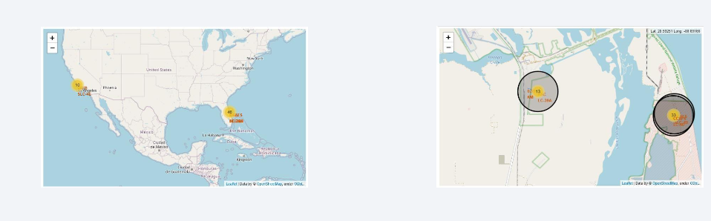
Results
Exploratory data analysis
SpaceX had increased success rate of landing from 2015 to 2020
Falcon 9 rockets is the most reliable booster version
Average payload is around 3,000 kg
Interactive Screenshots on the right
Predictive analysis
Decision Tree is the best predictor, with almost 90% accuracy
Best parameters are determined for each predictive model

Slide 17

Section 2

Slide 18
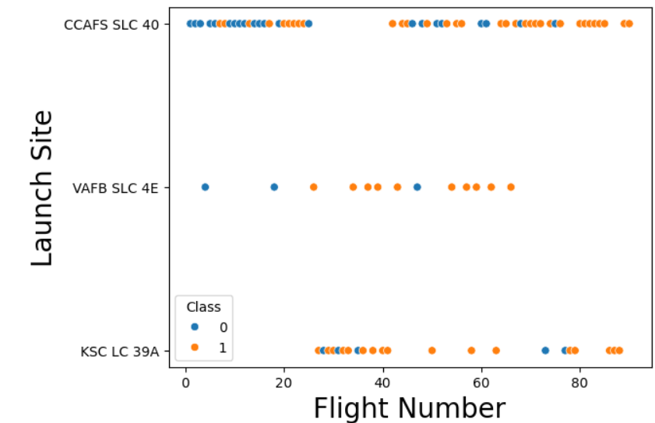
Flight Number vs. Launch Site
SLC 40 is the most used launch site, with increased success over experience.

Slide 19
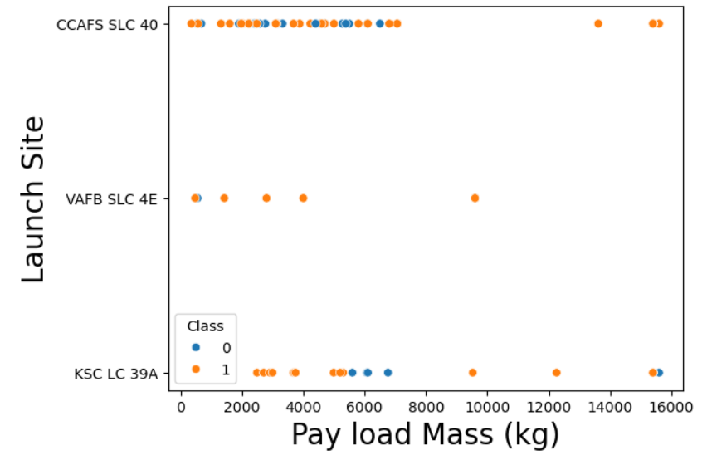
Payload vs. Launch Site
Most payloads are under 6000 kg

Slide 20
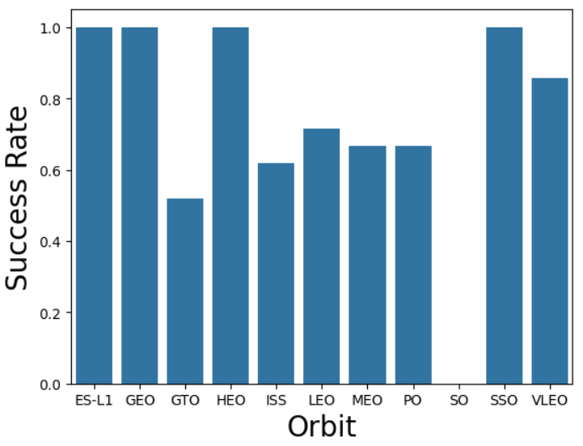
Success Rate vs. Orbit Type
Certain Orbits has perfect success rate

Slide 21
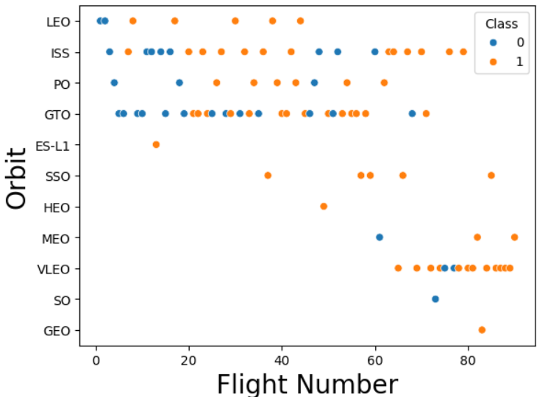
Flight Number vs. Orbit Type
There’s recent interest in VLEO orbit

Slide 22
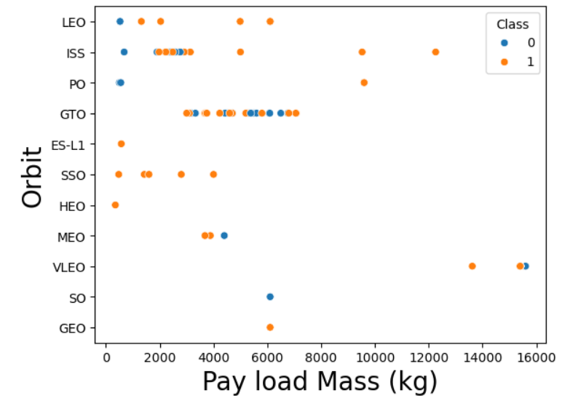
Payload vs. Orbit Type
GTO contains the bulk of normal payloads

Slide 23
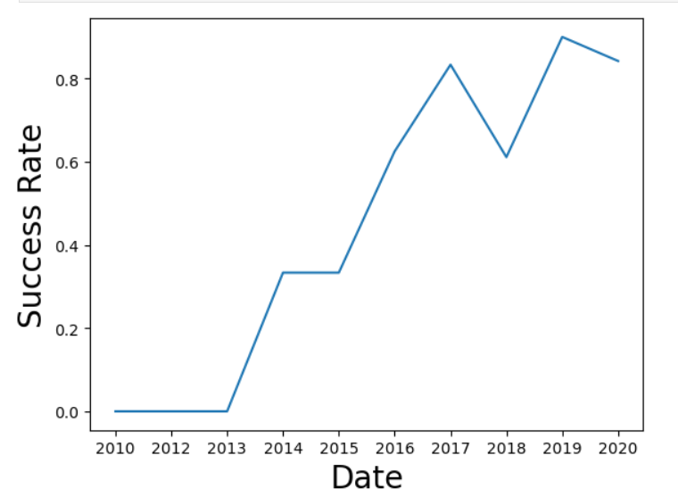
Launch Success Yearly Trend
Success rate has increased over the years, and may be plateau’d

Slide 24
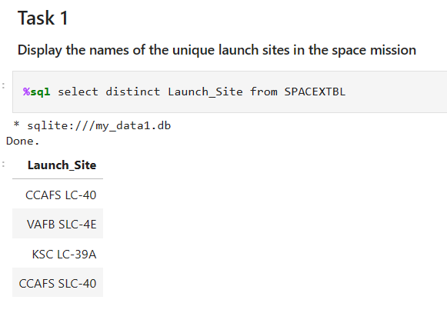
All Launch Site Names
There are 4 unique launch sites

Slide 25
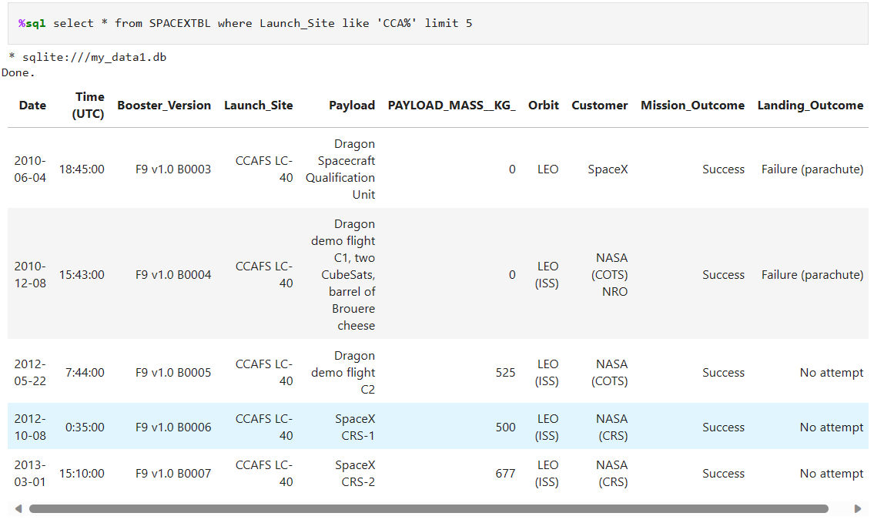
Launch Site Names Begin with 'CCA'

Slide 26
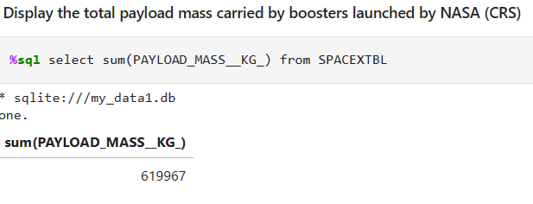
Total Payload Mass

Slide 27
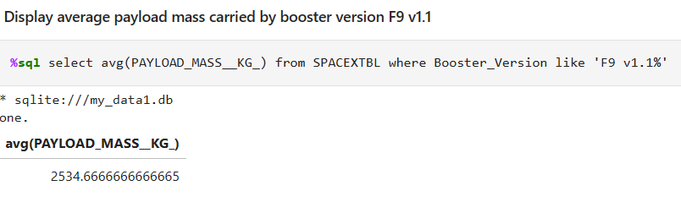
Average Payload Mass by F9 v1.1

Slide 28
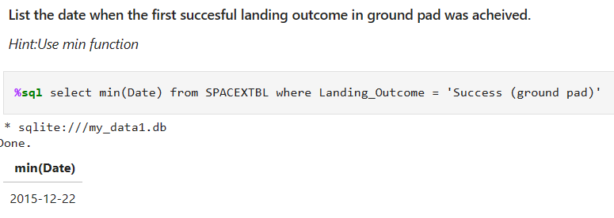
First Successful Ground Landing Date

Slide 29
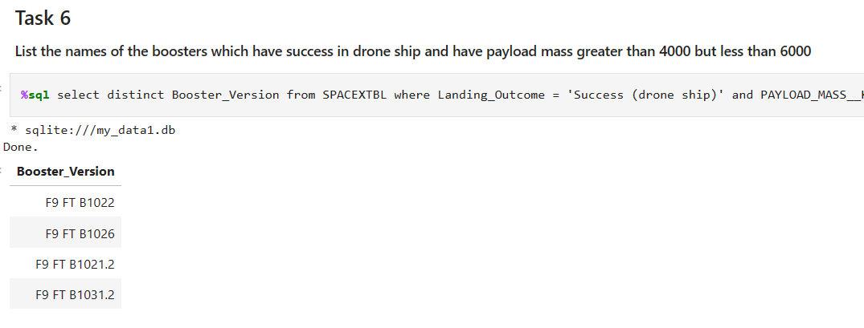
Successful Drone Ship Landing with Payload between 4000 and 6000

Slide 30
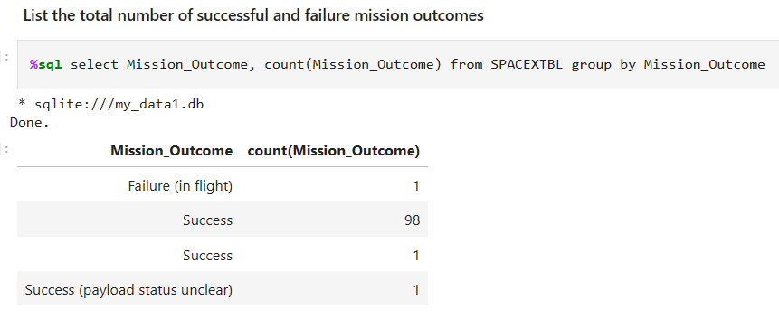
Total Number of Successful and Failure Mission Outcomes
SpaceX considers most missions “successful”

Slide 31
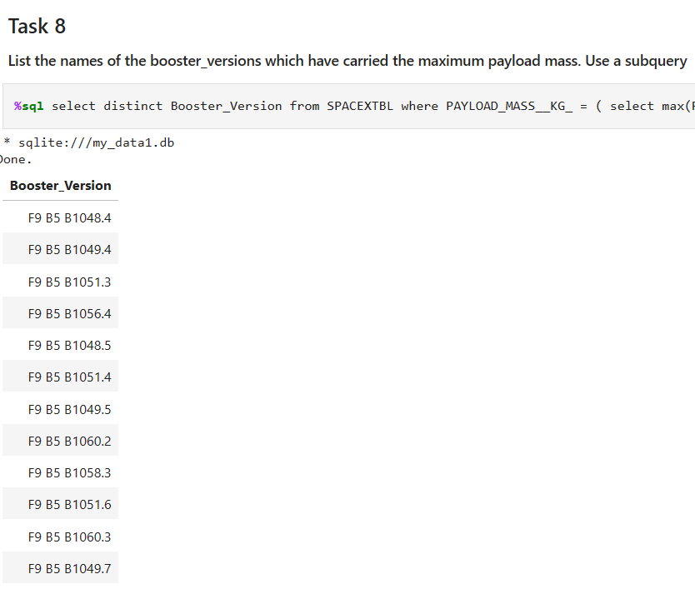
Boosters Carried Maximum Payload
Multiple booster versions had carried max payload

Slide 32
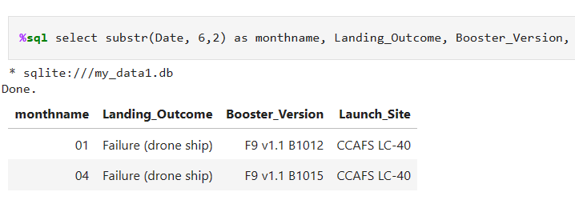
2015 Launch Records
Two notable landing failures in 2015

Slide 33
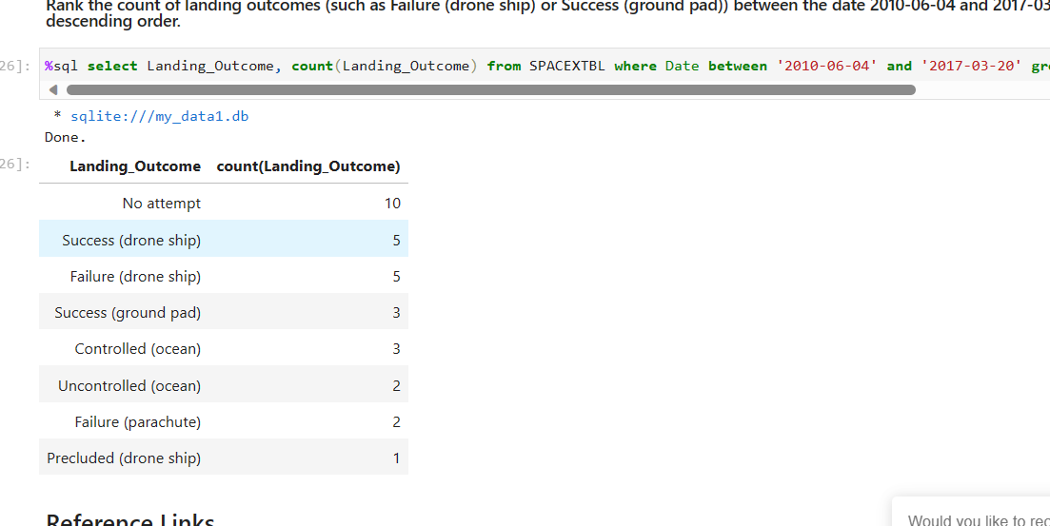
Rank Landing Outcomes Between 2010-06-04 and 2017-03-20

Slide 34

Section 3

Slide 35
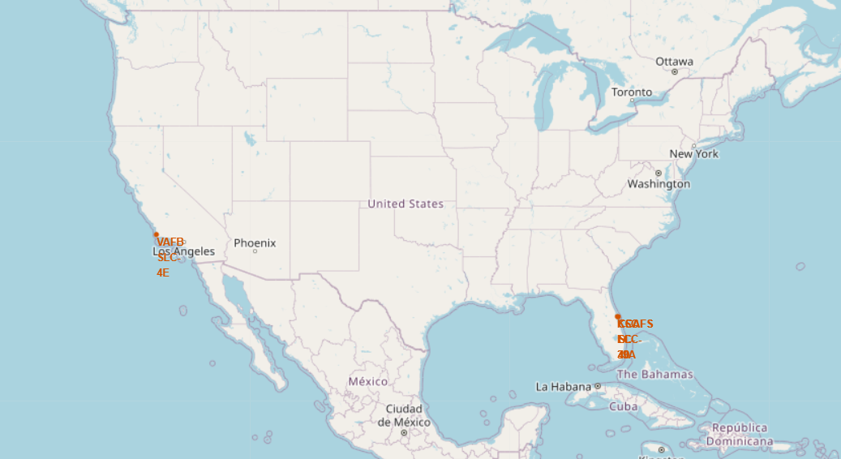
Launch Site Locations

Slide 36
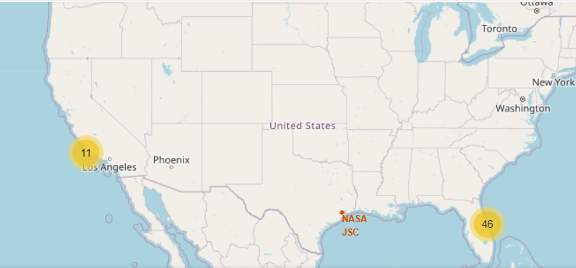
# of Launches Per Location

Slide 37
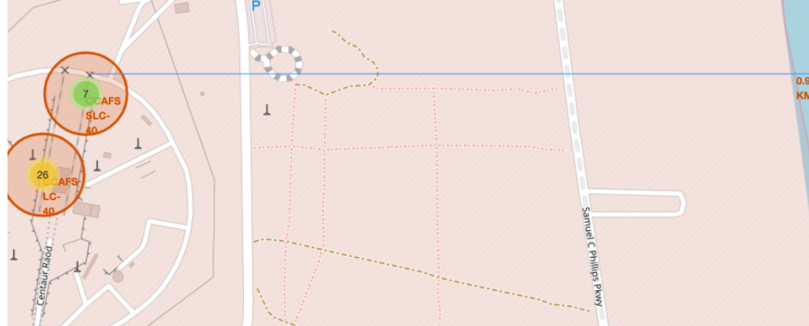
Launch Site Distance From Shore

Slide 38

Section 4

Slide 39
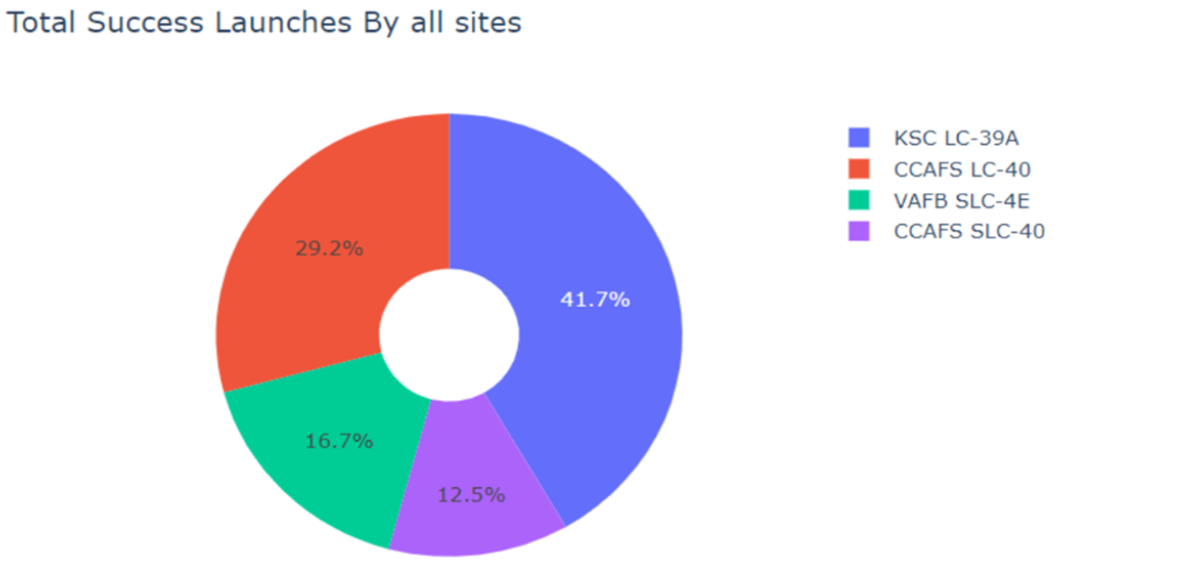
KSC LC-39A Has The Most Success

Slide 40
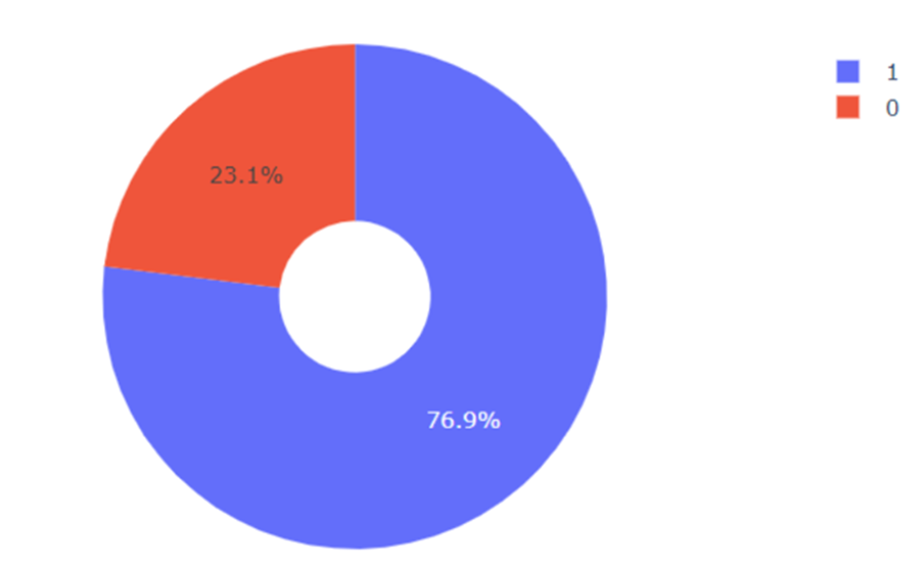
Deep Dive Into KSC LC-39A Success Rate

Slide 41
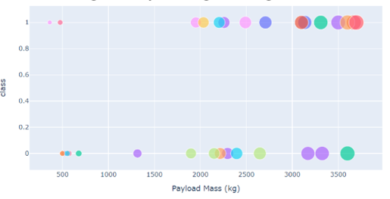
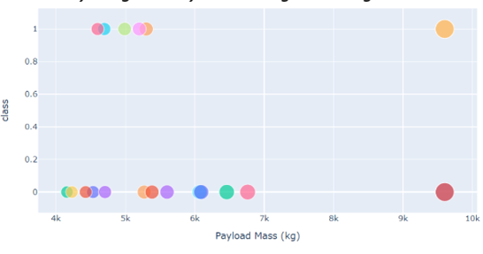
Lower Weight = More Success

Slide 42

Section 5

Slide 43
Classification Accuracy
Visualize the built model accuracy for all built classification models, in a bar chart
Find which model has the highest classification accuracy

Slide 44

Confusion Matrix – Decision Tree
Decision tree had the least false-positive prediction

Slide 45
Conclusions
Certain Launch Sites has better landing rate
Certain Orbits leads to better success
Payload contributes to success rate
Decision Tree can better predict success

Slide 46
Appendix
Python Data Science Handbook | Python Data Science Handbook (jakevdp.github.io)

Slide 47


